Slide 1
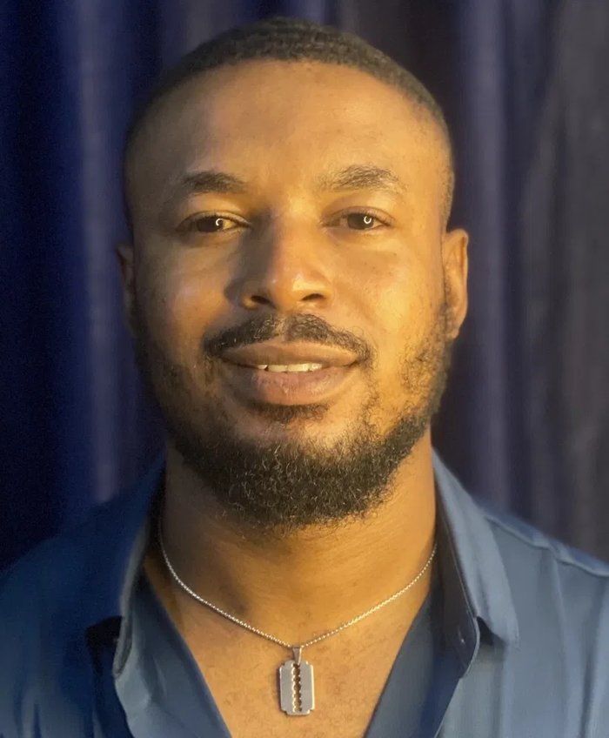
DIGITAL MARKETING & GROWTH PORTFOLIO
2025 EDITION
JIBOLA JEGEDE
Turning Media Investment Into
Measurable Growth.
Senior Digital Marketing Strategist & Growth Leader with 8+ years building, running and optimizing full-funnel paid media programs for Africa's leading consumer, financial and travel brands.
$2.5M+ Managed
5x Avg. ROAS
Google · Meta · TikTok · LinkedIn
8+ Years
Lagos, Nigeria · jegedejib@gmail.com · +234 706 052 6532
Head of Marketing, Utopia Media Group

Slide 2
EXECUTIVE PROFILE
A growth strategist who treats every naira and dollar of media spend as an investment to defend.
WHAT I DO
Jibola Jegede has spent the last eight years inside the three rooms that decide whether a marketing budget performs: the strategy table, the ads dashboard, and the boardroom where results get explained. He has sat on the platform side at Meta, consulting for over 3,000 advertisers across Sub-Saharan Africa, and on the brand side, running eight-figure media programs for household names like Pepsi, PZ Cusson, Rwand Air, VFD Group, South Africa Tourism, Apex Network, Old Mutual, Jameson, Evercare Hospital, and several others.
That dual vantage point is his edge; he builds the measurement frameworks, trains the teams, and translates platform data into the language executives need to keep investing: an average 5x ROAS, 47% lead growth, and 68% organic traffic lift delivered through full-funnel execution.
Today, as Head of Marketing at Utopia Media Group, he leads strategy and execution for a multi-brand portfolio spanning FMCG, financial services, travel, betting, entertainment, and healthcare.
Strategy & Planning
01
Full-funnel digital strategy tied to business KPIs.
02
Media Investment
Managing six- to seven-figure budgets across platforms.
03
Performance Optimization
Turning GA4 & Ads Manager data into ROAS lift.
"I don’t measure a campaign by whether it ran; I measure it by whether it moved a number the business actually cares about."
04
Team & Client Leadership
Mentoring marketers, advising 3,000+ advertisers.
EXECUTIVE PROFILE
02 / 17

Slide 3
IMPACT AT A GLANCE
Eight years of campaigns, distilled into the numbers that matter to a business.
$2.5M+
5x
47%
68%
Paid media managed across Google, Meta, TikTok, LinkedIn & programmatic
Average ROAS delivered across managed budgets
Lead growth driven through full-funnel execution
Organic traffic lift through SEO & content optimization
3,000+
100+
14
9+
Advertisers consulted across Sub-Saharan Africa at Meta
Training sessions & audits delivered to brand/agency teams
Recognized brands led across FMCG, finance, travel & health
Years of hands-on digital marketing & growth leadership
Figures reflect cumulative and campaign-level results across Utopia Media Group, Aleph, Teleperformance/Meta, MoneyTrust Microfinance Bank and Stylewithjibs engagements, 2016–present.
IMPACT AT A GLANCE
03 / 17

Slide 4
CORE EXPERTISE
Four disciplines, one growth engine.
From strategy through execution to the numbers on the boardroom slide.
Strategy & Planning
Paid Media & Performance
Full-funnel digital marketing strategy
Go-to-market & channel planning
Marketing attribution & measurement
Lead generation & sales funnel design
PPC & SEM (Google Ads)
Paid social (Meta, X, LinkedIn, TikTok)
Programmatic & display advertising
Mobile app & ASO promotion
Analytics & Optimization
Leadership & Enablement
Web analytics & visualization (GA4, Tableau)
A/B testing & CRO
SEO & keyword research
Email automation & CRM
Team mentorship & management
Client & stakeholder advisory
Cross-functional collaboration
Training & capability building
CORE EXPERTISE
04 / 17

Slide 5
CAREER JOURNEY
From campus growth projects to eight-figure media budgets.
2024—Present
Head of Marketing
Utopia Media Group
EDUCATION
Leading digital strategy & execution for a multi-brand portfolio.
MBA, Business Administration
2022—2024
Meta Client Partner
University of Lagos, Akoka · 2022–2024
Aleph
Grew a $1M+ client portfolio 30% YoY across tech, retail & finance.
B.Sc, Economics
2019—2022
Senior Marketing Expert
University of Lagos, Akoka · 2012–2016
Teleperformance / Meta
Consulted 3,000+ advertisers; Best Agent, 4+ quarters.
2019
Head, E-Channels & Digital Mktg
MoneyTrust Microfinance Bank
Built the bank's first digital marketing function & budget.
2016—2019
Merchant Acquisition & Project Lead
Yuuzoo Corporation
Drove merchant & user acquisition for a 200M-user platform.
2017—Present
Founder
Stylewithjibs
Built a fashion & content brand to 2,000+ monthly organic visitors.
CAREER JOURNEY
05 / 17

Slide 6







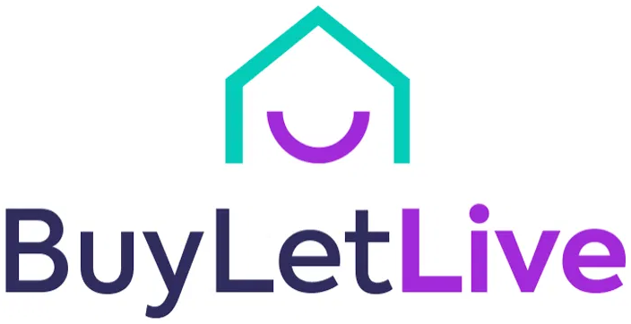









BRAND PORTFOLIO
Brands trusted with real media budgets.
Across agency, platform-consulting, and in-house roles — FMCG, financial services, travel, healthcare, retail, fitness, fintech, and founder-led ventures.
BEVERAGE / FMCG
BEVERAGE / FMCG
FMCG
FMCG
FMCG
FINANCIAL SERVICES
Pepsi
Aquafina
Premier Cool
Cussons Baby
Mama's Nest
VFD Group
TRAVEL / AVIATION
TRAVEL
REAL ESTATE
HEALTHCARE
FMCG
SPIRITS / FMCG
RwandAir
South African Tourism
BuyLetLive
Evercare Hospital
McVities
Jameson
RETAIL
FOUNDER BRAND
FINANCIAL SERVICES
FITNESS APPAREL / E-COMMERCE
CRYPTO / FINTECH
Bottle King Nigeria
Stylewithjibs
Old Mutual
Toned Fit (Toned Edge)
Apex Network
BRAND PORTFOLIO
06 / 19

Slide 7
CASE STUDY · 01
Building one growth engine for a multi-brand agency roster.
Head of Marketing
Utopia Media Group · Jul 2024–Present
THE CHALLENGE
MY APPROACH
Utopia Media Group manages digital for a wide portfolio — Pepsi, Aquafina, Premier Cool, Cussons Baby, Mama's Next and more — each with different KPIs, audiences and media mixes. The brief: build one repeatable strategy engine capable of scaling media investment across every brand without diluting performance.
Designed a full-funnel strategy framework covering SEO, SEM, paid social, content & email
Standardized measurement using GA4, SEMrush & Meta Ads Manager across every brand
Managed $30K+ monthly media budget across Google, Meta, TikTok, LinkedIn & programmatic
Built and mentored the digital team executing the work day-to-day
$30K+
6
5+
Monthly ad budget managed across platforms
Channels unified under one reporting framework
Major brands under active strategy & execution
Results from this engagement continue on the following slide.
CASE STUDY · UTOPIA MEDIA GROUP
07 / 17

Slide 8
CASE STUDY · 01 (CONTINUED)
The results the strategy delivered.
30%
5x
45%
Growth in brand penetration across the portfolio within four months
Average ROAS achieved through data-driven media optimization
Increase in digital revenue within 12 months of campaign execution
40%
3x
6
Uplift in audience reach across YouTube, Instagram, X & Google Ads
Increase in content engagement across multi-platform campaigns
Analytics & reporting platforms unified into one performance framework
BRANDS UNDER THIS ENGAGEMENT
Pepsi
Aquafina
Premier Cool
Cussons Baby
Mama's Next
RwandAir
South African Tourism
BuyLetLive
Bottle King Nigeria
CASE STUDY · UTOPIA MEDIA GROUP
08 / 17

Slide 9
CASE STUDY · 02
Growing a seven-figure Meta client portfolio from the platform side.
Meta Client Partner
Aleph · Sep 2022–Jun 2024
CONTEXT
30%
Aleph connects 22,000+ advertisers across 130+ underserved markets to Meta's platforms. As Meta Client Partner, Jibola owned a portfolio of accounts across tech, gaming, retail and finance — responsible for both revenue growth and campaign performance.
YoY revenue growth across the managed portfolio
95%
Client satisfaction rate maintained across the portfolio
WHAT HE DID
Managed and grew a $1M+ client portfolio through strategic account activation
Consulted on Meta Ads strategy — pixel integration & advanced audience segmentation
Delivered 100+ training sessions and campaign audits for agency & brand teams
Analyzed funnel performance in Ads Manager to guide campaign refinements
15%
Increase in campaign effectiveness from performance reporting
40%
Adoption rate of proposed marketing solutions
CASE STUDY · ALEPH
09 / 17

Slide 10
CASE STUDY · 03
Scaling advertiser success at platform level, across a continent.
Senior Marketing Expert
Teleperformance / Meta · Dec 2019–Aug 2022
Embedded within Meta's advertiser-support partnership with Teleperformance, Jibola consulted directly for businesses across every major vertical in Sub-Saharan Africa — e-commerce, fintech, betting, leisure & hospitality, transportation, and education — setting KPIs, auditing accounts, and coaching advertisers toward stronger ROAS.
50%+
Average ROI driven for consulted advertisers
Consulted for 3,000+ advertisers across Sub-Saharan Africa
Activated & scaled accounts against ROAS, CTR & CAC targets
Delivered vertical-specific strategy playbooks (e-commerce, fintech, education)
Mentored junior marketing professionals into the team's growth
4+
Consecutive quarters awarded overall Best Agent
CASE STUDY · TELEPERFORMANCE / META
10 / 17

Slide 11
CASE STUDY · 04
Building a bank's first digital marketing function from zero.
Head, E-Channels & Digital Marketing
MoneyTrust Microfinance Bank · Apr–Dec 2019
THE SITUATION
500+
MoneyTrust, a CBN-licensed microfinance bank, had no structured digital function and no marketing budget when Jibola joined. The mandate: build brand visibility, digital acquisition, and a real marketing operation from scratch.
SME leads generated through demand campaigns
150+
WHAT WAS BUILT
New accounts opened via digital acquisition
Demand generation campaigns for SME leads & account opening
An SEO-optimized website & mobile app acquisition funnel
CRM automation for lead nurturing across the customer lifecycle
The bank's first structured marketing budget & partnership pipeline
80%
Increase in digital customer acquisition within 8 months
55%
Boost in brand awareness via CRM & visibility campaigns
CASE STUDY · MONEYTRUST MICROFINANCE BANK
11 / 17

Slide 12
FOUNDER SPOTLIGHT
Stylewithjibs — proof he can build a brand, not just run someone else's.
Founder / SEO & Digital Ad Specialist
Stylewithjibs · Jan 2017–Present
Alongside his agency career, Jibola built Stylewithjibs from the ground up, transforming it from a personal styling concept into a recognised men’s fashion, content, and e-commerce platform. His contribution spans the full commercial and digital lifecycle of the business, from defining the brand and commercial strategy to managing paid media, CMS and e-commerce operations, SEO architecture, content strategy, social media, customer acquisition and retention, as well as influencer and creator partnerships. He has remained deeply involved in understanding customer behaviour, developing the product and content proposition, building the customer database, and continuously optimising the channels that drive sales and growth. Stylewithjibs is therefore more than a side venture; it is a practical demonstration of Jibola’s ability to take ownership across strategy, technology, marketing, content, commerce, and execution and turn an idea into a growing, customer-led business.
0 → 5,000+
6x
4,000+
Featured
Monthly organic visitors across online channels (website and social media platforms) via backend & SEO rebuild
Increase in ROI and ROAS across content-driven campaigns
Social-driven sales via paid ads, influencer partnerships & UGC
In Business Day Newspaper as a fashion platform to watch
FOUNDER SPOTLIGHT · STYLEWITHJIBS
12 / 17

Slide 13
TESTIMONIALS & RECOGNITION
What clients, partners, and platforms have said — in their own words.
“
“
This guy works with me for over a month, constantly looking at my ads, following up on what we were doing and helping us more than double our reach and actual sales numbers. The customer service, the follow-through, the real, in-your-face advice, and the results. Thanks, Jibola, you're the bomb!
WOW! What an achievement! From everyone in SBG EMEA, a huge thank you for such great work. It's an incredible achievement to see great overall performance last quarter, hitting 71% SL, 91% BCR, and 8.41 TSA. Onwards and upwards from here!
Kesiena Ogbemi
LINKEDIN RECOMMENDATION
Adrian Ma
INTERNAL RECOGNITION EMAIL
Digital, Growth & Marketing Leader · Ex-Kraft Heinz, Nokia, GSK, P&G
Regional Sales Manager, Small Business Group EMEA · Meta
“
“
I had a great experience learning from Jibola Jegede about social media marketing, selecting the niche, choosing the right platform, running campaigns, and understanding the algorithm behind it all.
I write this to heartily congratulate you on your outstanding performance, emerging overall best in the ME Core program for the month of July 2020. Keep it up, our amiable agent. Teleperformance Nigeria recognizes your good work!
Hermain G.
LINKEDIN POST
Oluwafemi D. Ayeni
INTERNAL RECOGNITION EMAIL
Creative Content Writer · Workshop attendee, Qureos
HR & Admin Officer · Teleperformance Nigeria
“
Congratulations! You have been nominated to take the JUMP! Certification for Supervisor. This course will give you insights about the requirements for the Team Lead role, it's always good when preparation meets opportunity.
Diana Ufuah
HR Assistant · Teleperformance Nigeria
TEAM LEAD NOMINATION EMAIL
TESTIMONIALS & RECOGNITION
13 / 17

Slide 14
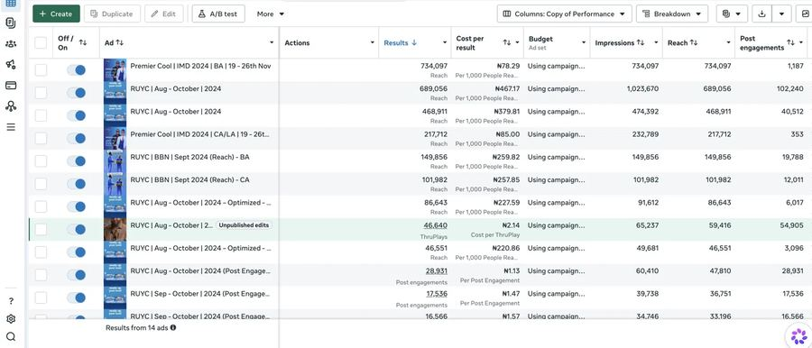
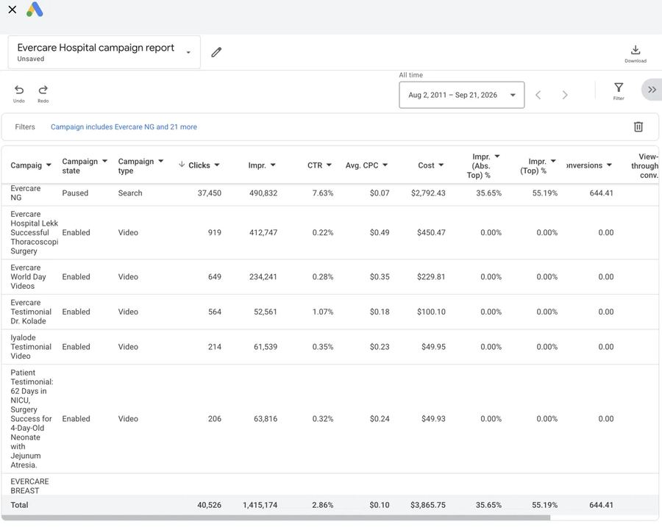
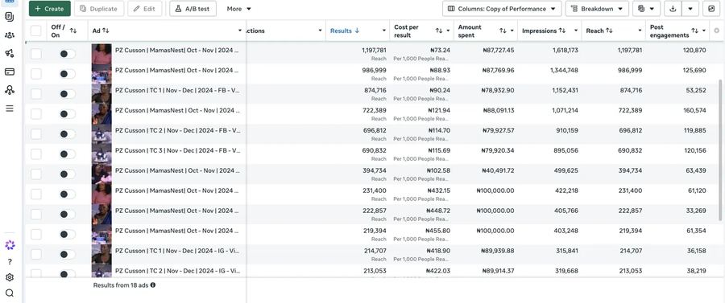
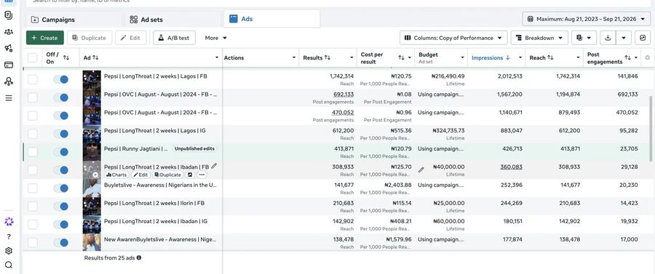
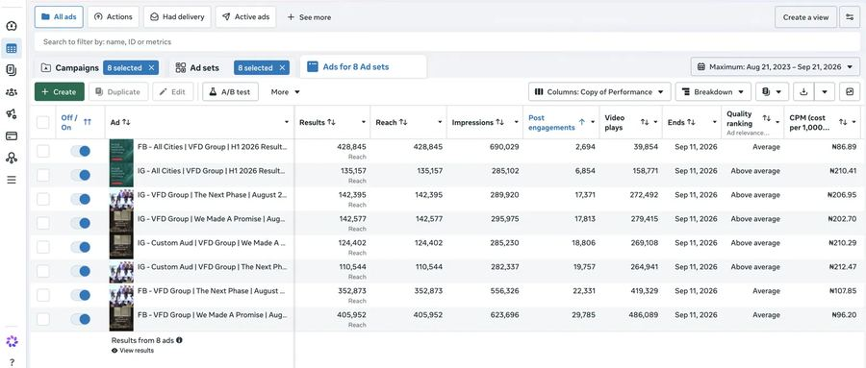
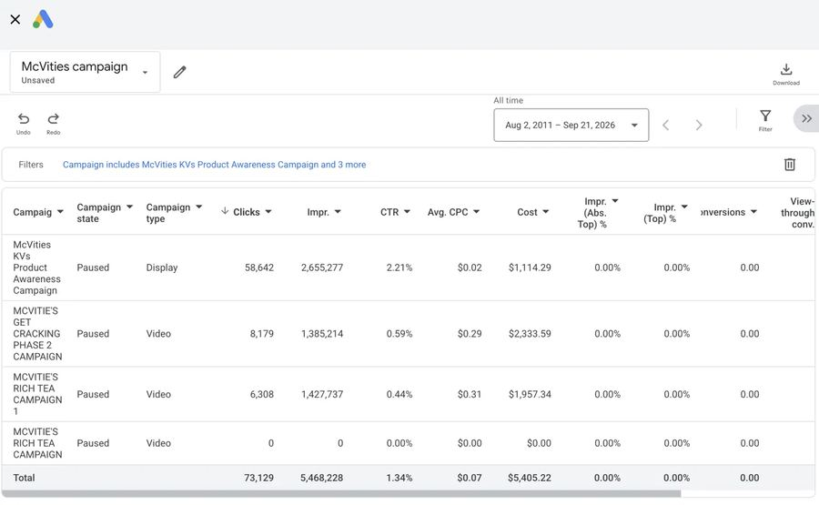
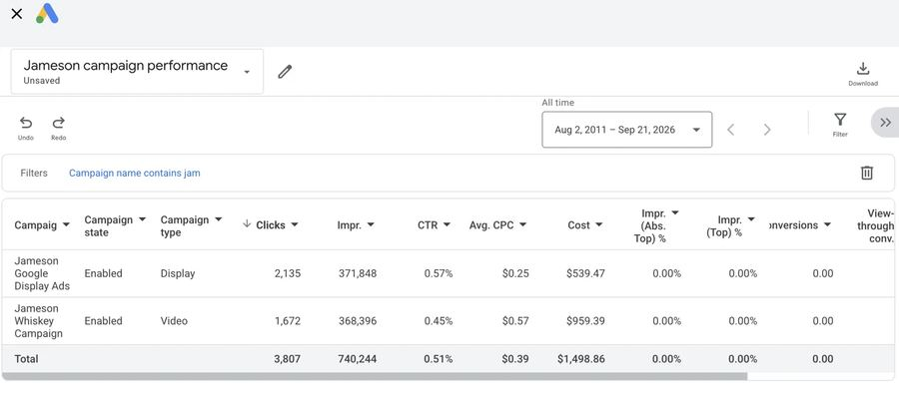
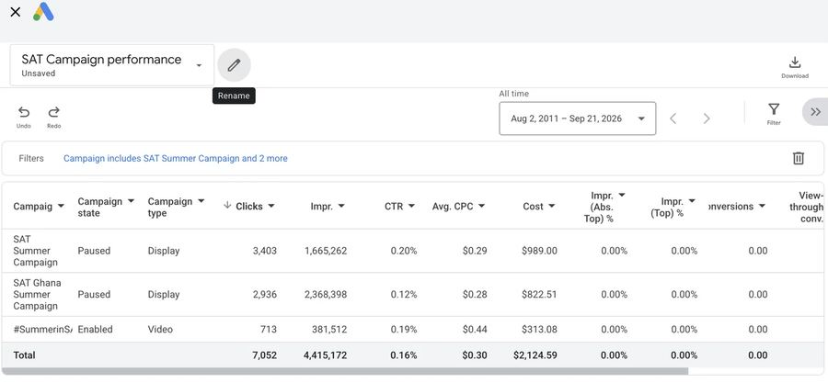
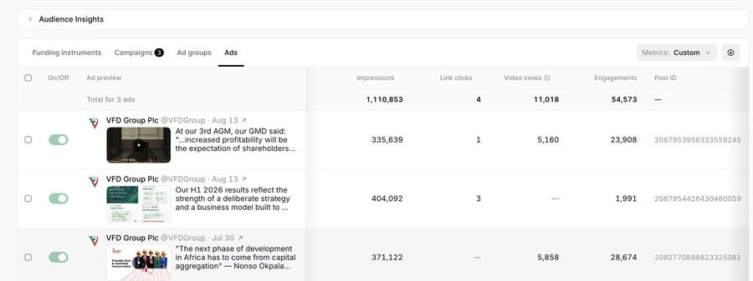
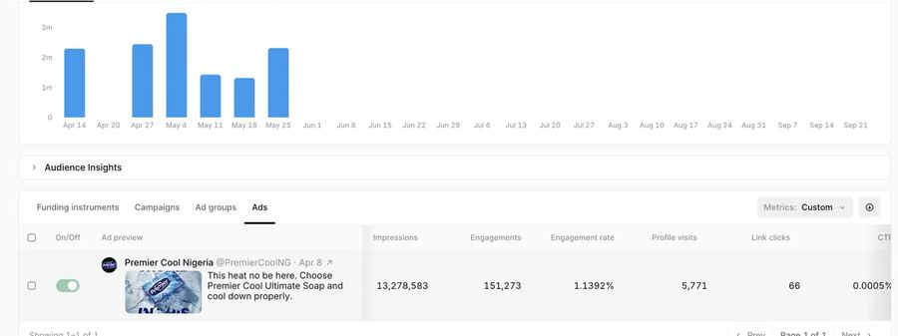
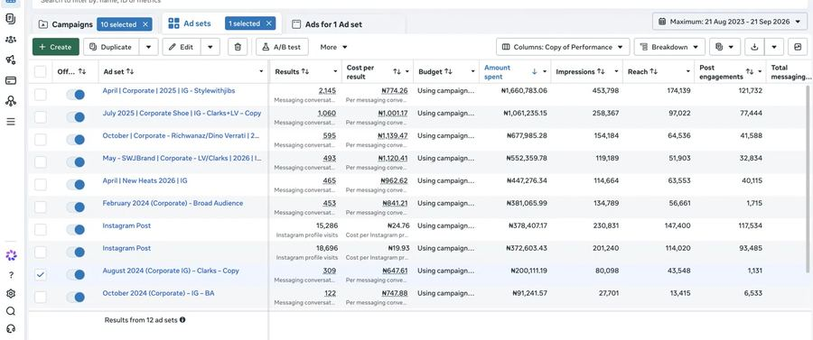
PROOF OF PERFORMANCE
Real dashboards. Real campaigns. Real numbers.
Includes dedicated case studies — Apex Network , Old Mutual, & Toned Fit (next 3 slides).
PROOF OF PERFORMANCE
14 / 19

Slide 15
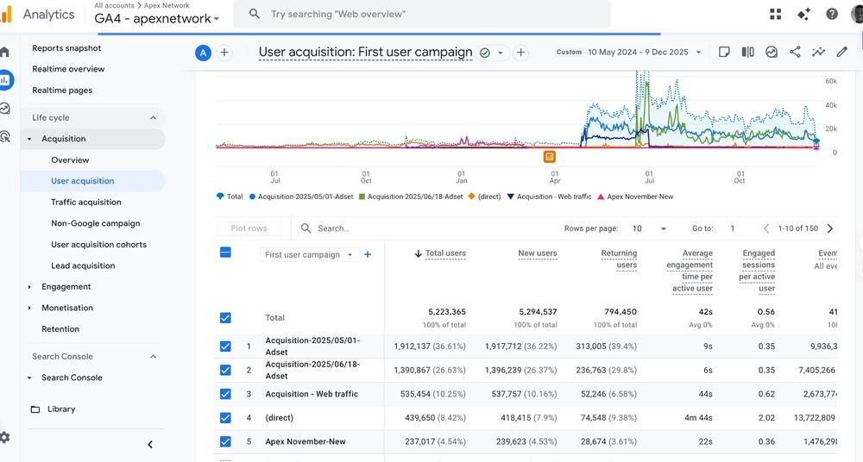
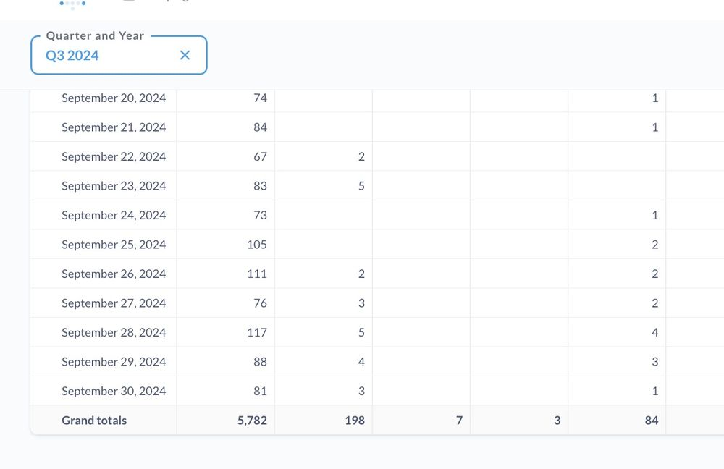
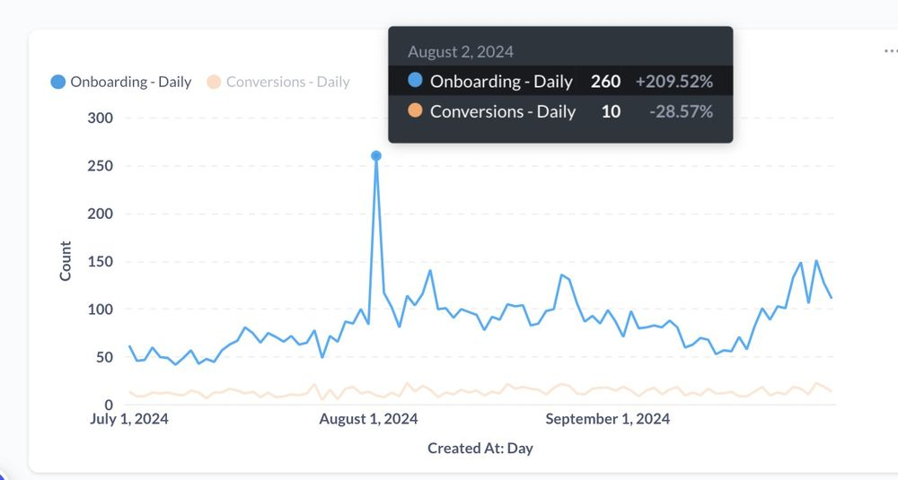
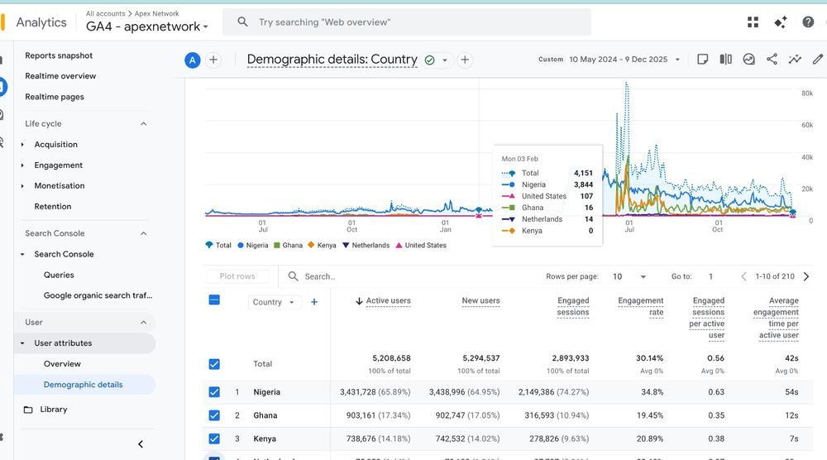
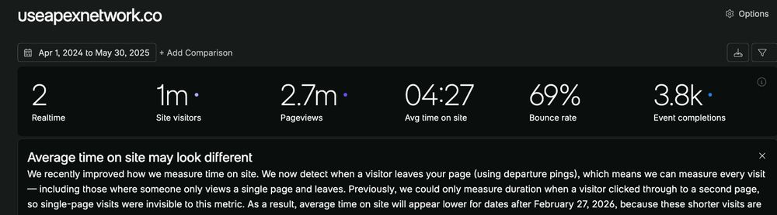
CLIENT REPORTING · APEX NETWORK
Measuring a crypto/fintech growth push across Nigeria, Ghana and Kenya.
5.2M+
65.9%
2.7M
260
Active users tracked in GA4 across the engagement window
of users from Nigeria, followed by Ghana (17.3%) and Kenya (14.2%)
Pageviews recorded Apr 2024–May 2025, avg. 4:27 on site
Peak daily onboardings (2 Aug 2024), +209% day-on-day
GA4 · Demographic details by country
GA4 · User acquisition by campaign
Onboarding vs conversions, daily
Q3 2024 daily reporting table
Site analytics · useapexnetwork.co
CLIENT REPORTING · APEX NETWORK
17 / 19

Slide 16
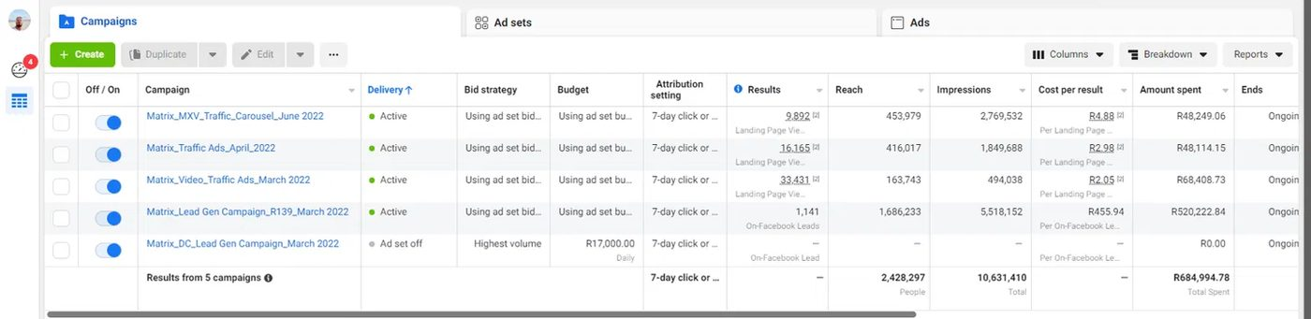
CLIENT REPORTING · OLD MUTUAL (SOUTH AFRICA)
Running a multi-campaign traffic & lead-gen push across the South African market.
Financial Services · Meta Ads Manager · Objective: landing-page traffic & on-platform lead generation · Mar–Jun 2022
2.43M
10.6M
R684,994.78
R2.05
Total people reached across 5 Matrix campaigns
Total impressions delivered, Mar–Jun 2022
Total media spend under direct management
Lowest cost per result, on the video traffic campaign
CAMPAIGN
STATUS
RESULTS
RESULT TYPE
REACH
IMPRESSIONS
CPR
SPEND
Matrix_MXV_Traffic_Carousel_June 2022
Active
9,892
Landing page views
453,979
2,769,532
R4.88
R48,249.06
Matrix_Traffic Ads_April_2022
Active
16,165
Landing page views
416,017
1,849,688
R2.98
R48,114.15
Matrix_Video_Traffic Ads_March 2022
Active
33,431
Landing page views
163,743
494,038
R2.05
R68,408.73
Matrix_Lead Gen Campaign_R139_March 2022
Active
1,141
On-Facebook leads
1,686,233
5,518,152
R455.94
R520,222.84
Matrix_DC_Lead Gen Campaign_March 2022
Ad set off
—
On-Facebook lead
—
—
—
R0.00
Totals · 5 campaigns
2,428,297
10,631,410
R684,994.78
PERFORMANCE BREAKDOWN
Five concurrent campaigns balanced awareness, traffic, and lead objectives for Old Mutual across South Africa. Cost per result improved steadily as the traffic campaigns matured, dropping from R4.88 to R2.05 per landing page view. The lead-gen campaign carried a naturally higher cost per result (R455.94), reflecting the higher intent of an on-platform lead vs. a page view, while still generating 1,141 qualified leads.
CLIENT REPORTING · OLD MUTUAL
15 / 19

Slide 17
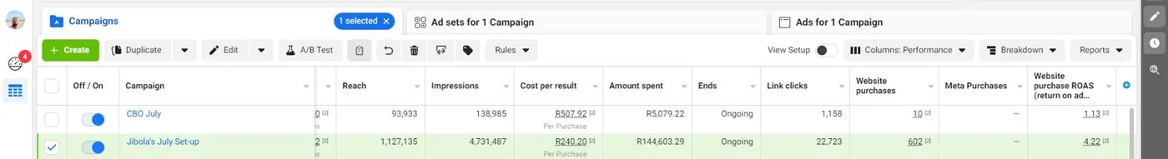
CLIENT REPORTING · TONED FIT (SOUTH AFRICA)
Lifting e-commerce ROAS 3.7x for a South African fitness & apparel brand.
E-commerce / Fitness Apparel · Meta Ads Manager (CBO) · Objective: website purchases · July engagement
4.22x
612
R149,682.51
23,881
Website purchase ROAS on the optimized ad set — a 3.7x lift over baseline
Combined website purchases driven across both ad sets
Combined media spend across the July engagement
Combined link clicks driving traffic to the Toned Fit store
AD SET
REACH
IMPRESSIONS
COST / PURCHASE
SPEND
LINK CLICKS
PURCHASES
ROAS
CBO July
93,933
138,985
R507.92
R5,079.22
1,158
10
1.13x
Baseline ad set
Jibola's July Set-up
1,127,135
4,731,487
R240.20
R144,603.29
22,723
602
4.22x
Optimized ad set
PERFORMANCE BREAKDOWN
“CBO July” served as the baseline ad set, a modest R5,079 spend returning a 1.13x purchase ROAS. Rebuilding the campaign as “Jibola's July Set-up,” with sharper audience targeting and campaign budget optimization, scaled reach 12x (to 1.13M people) while nearly halving cost per purchase (R507.92 → R240.20). Result: 602 website purchases at a 4.22x ROAS.
CLIENT REPORTING · TONED FIT
16 / 19

Slide 18
CREDENTIALS
Certified across the platforms he runs media on.
CERTIFICATIONS
TOOL STACK
Media Planning
Meta
Google Analytics (GA4)
Google Ads
Meta Ads Manager
Meta
LinkedIn Campaign Manager
SEMrush
Moz
Tableau
Media Buying
Meta
Meta
Looker Studio
Salesforce
HubSpot
MailerLite
Discovery Commerce
Meta
SimilarWeb
Zapier
Google Tag Manager
Hotjar
Facebook Certified Digital Marketing Associate
Meta
Screaming Frog
Google Ads Certification (Search, Display)
Google
Google Analytics 4 (GA4) Certification
VOLUNTEER & ENABLEMENT
Google
Trained 60+ professionals on PPC & marketing automation (Qureos)
Facilitated digital workshops in Ghana & Nigeria
Media strategist (Lagos Youth to Business Forum "Y2BLAGOS)
E-commerce Analytics: From Data to Decision
Google
Enterprise Design Thinking Practitioner
IBM
Meta
Programmatic Certification
Media Planning
Eskimi
CREDENTIALS
18 / 19

Slide 19
LET'S BUILD SOMETHING GROWTH-SHAPED
Ready to turn your media budget into a measurable growth story.
Strategy, media investment, and performance optimization for brands that want their marketing to answer to the numbers.
jegedejib@gmail.com
+234 706 052 6532
Lekki, Ajah, Lagos, Nigeria
Jibola Jegede · Senior Digital Marketing Strategist & Growth Leader
References available on request

